Slide 1
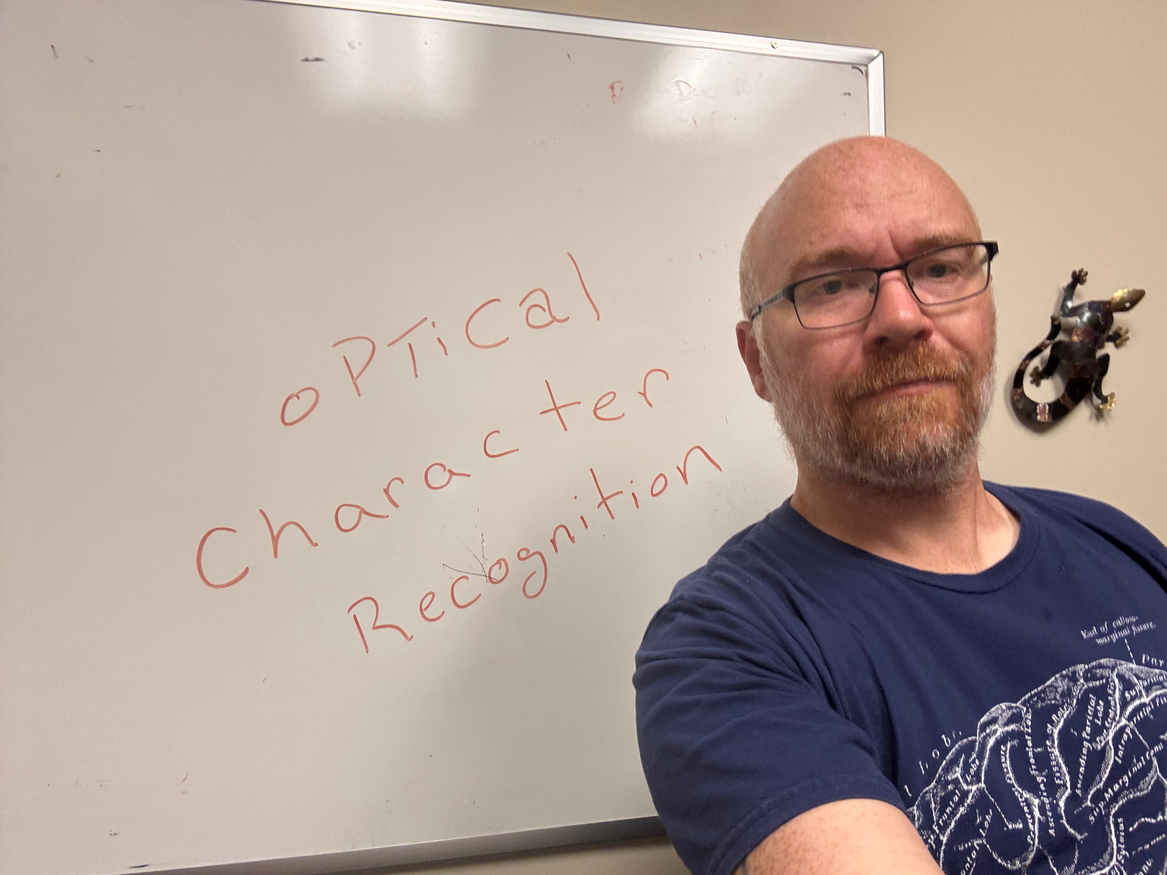
Lecture 18 0PfiCa1 Chaca c ter Recojation
ECE 1390/2390

Slide 2
Project Updates (10/30 & 11/4)
What do I expect?
Progress update
10min informal presentation
Can use your own laptop or give me slides
Show off what you have done so far
Have you tried things that didn’t work?
What class lessons have you incorporated into the project? Any insights?
Have your objectives changed?
Has there been any unanticipated issues?
10/30
BokehSwap
DC not DC
AutonomousDriving
RepVision
FaceEmojiSwap
11/4
Team Sebastian, Timothy, Jake, & Tyler
Shopkeepr
The Riddlers
Touchfree

Slide 3
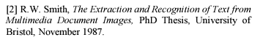
Tesseract OCR Engine
Developed by HP 1984-1994
Purchased by Google 2006-2018
Now open-source Apache-2.0 license
Executable
https://github.com/tesseract-ocr
Python Wrapper
https://pypi.org/project/pytesseract/

Slide 4
Tesseract OCR Engine
Step 1. Line Finding
Find connected components in the image → “blobs”
Filter small/large blobs
Sort along horizontal axis
For left to right:
If not blob overlaps row
make new row
Else
expand vertical bounds of row
end
Row -1
Row 0

Slide 5
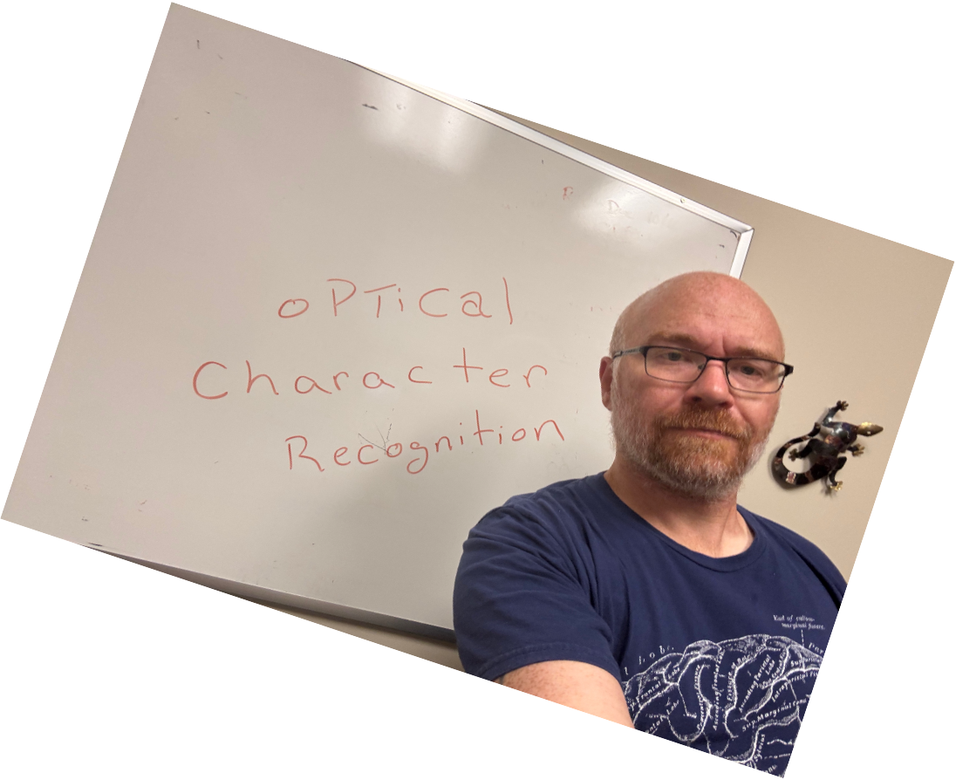
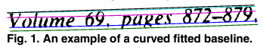





Tesseract OCR Engine
Step 2. Baseline Fitting

Slide 6
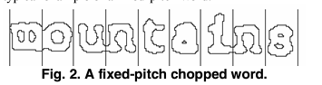
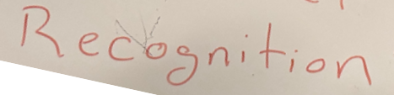

Tesseract OCR Engine
Step 3. Pitch Detection
and Chopping

Slide 7
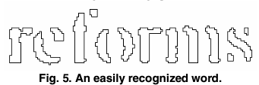
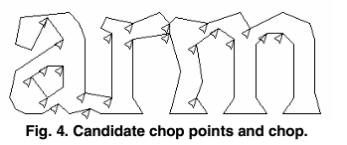
Tesseract OCR Engine
Loop.
Classify blobs to letters
if blob doesn’t match any letter
cut the blob
if cut blob doesn’t match any letter
associate broken segments

Slide 8
Limitations
Works best for printed characters (uniform spacing, uniform height, stylized lines)
Can handle oblique lines (or curves in baseline; book bindings)
Does not work with other stuff is in the image

Slide 9
EasyOCR
https://github.com/JaidedAI/EasyOCR
pip install easyocr
Trained on 80+ languages

Slide 10
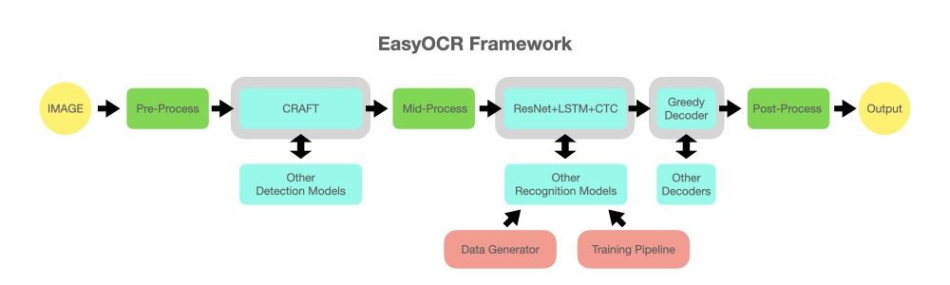
EasyOCR

Slide 11
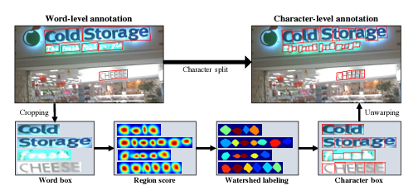
EasyOCR
CRAFT Detection
(Character Region Awareness for Text)
Trained U-net model to find center of character

Slide 12
Limitations
Works much better for real-world text
Code is a lot slower than Tesseract

Slide 13
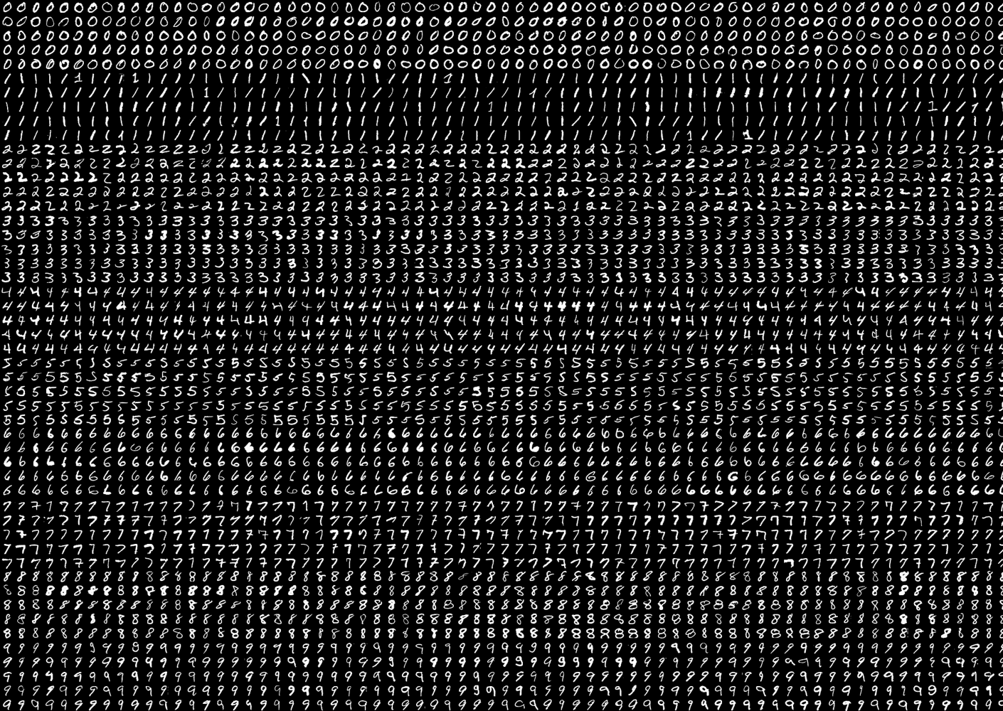
Digits example
From OpenCV Git samples
Example of HOG classifier

Slide 14
def preprocess_hog(digits):
samples = []
for img in digits:
gx = cv.Sobel(img, cv.CV_32F, 1, 0)
gy = cv.Sobel(img, cv.CV_32F, 0, 1)
mag, ang = cv.cartToPolar(gx, gy)
bin_n = 16
bin = np.int32(bin_n*ang/(2*np.pi))
bin_cells = bin[:10,:10], bin[10:,:10], bin[:10,10:], bin[10:,10:]
mag_cells = mag[:10,:10], mag[10:,:10], mag[:10,10:], mag[10:,10:]
hists = [np.bincount(b.ravel(), m.ravel(), bin_n) for b, m in zip(bin_cells, mag_cells)]
hist = np.hstack(hists)
eps = 1e-7
hist /= hist.sum() + eps
hist = np.sqrt(hist)
hist /= norm(hist) + eps
samples.append(hist)
return np.float32(samples)
Compute the directions of edges in the image
Make histogram of the distribution of magnitudes found at each angle
Normalize histograms

Slide 15
class SVM(object):
def __init__(self, C = 1, gamma = 0.5):
self.model = cv.ml.SVM_create()
self.model.setGamma(gamma)
self.model.setC(C)
self.model.setKernel(cv.ml.SVM_RBF)
self.model.setType(cv.ml.SVM_C_SVC)
def train(self, samples, responses):
self.model.train(samples, cv.ml.ROW_SAMPLE, responses)
def predict(self, samples):
return self.model.predict(samples)[1].ravel()
def load(self, fn):
self.model = cv.ml.SVM_load(fn)
def save(self, fn):
self.model.save(fn)
OpenCV is using a One-verses-All SVM model
model = SVM(C=2.67, gamma=5.383)
model.train(samples_train, labels_train)

Slide 16
From OpenCV’s Help description:
Gamma:
Role: Defines the influence of a single training example. It controls the "width" of the RBF kernel (the most commonly used kernel with SVMs).
Interpretation:
Low gamma: The influence of a single training example reaches far, leading to a smoother decision boundary and a more generalized model.
High gamma: The influence of a single training example is localized, leading to a more complex decision boundary that closely fits the training data (potentially overfitting).
C:
Role: Controls the trade-off between maximizing the margin and minimizing the classification error.
Interpretation:
Low C: A larger margin is encouraged, potentially leading to misclassifications on the training data but creating a simpler model that generalizes better.
High C: The model tries to correctly classify all training examples, potentially leading to a more complex decision boundary and overfitting.

